Slide 1
The fraud detectors
Akhil Kusuma
Angela Ossana
Anurag ramu
SAMANVITH CHETLAPALLI
Srinivasa vutukuri

Slide 2
TYPES OF FRAUD
CREDIT CARD FRAUD
INSURANCE CLAIMS FRAUD
FORGERY
PHONY POLICY
[1] L. Sachon, “Types of Frauds,” Policygenius. [Online]. [Accessed: 08-Dec-2019].
AKHIL KUSUMA

Slide 3
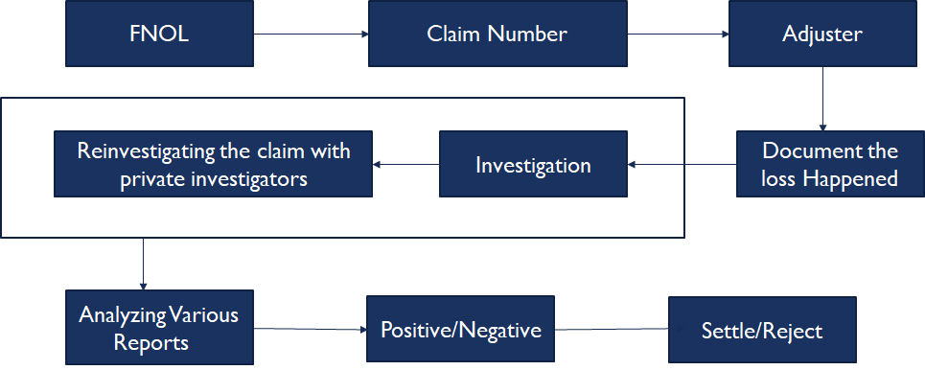
Traditional Claim Process
AKHIL KUSUMA

Slide 4
Challenges in traditional method
Requires a lot of human intervention to physically analyze claims data
Time taken to analyze claims and award compensation to the customer takes several months
The current scenario lacks consistency with respect to analysis
Fraud analysis costs a company more time, money and resources
Existing (anomaly detecting) software is not accurate and cannot undergo reinforced learning
AKHIL KUSUMA

Slide 5
Problem Statement
Insurance Fraud is a deliberate move or deception created either by the insurer or by the insurance company or agent to maximize the financial gain.
Common frauds include 'Padding' or exaggerating/inflating actual claims, misinterpreting facts, submitting false claims pertaining to damage or accidents that never occurred.
Every year state/federal governments, Private Insurance firms lose billions of dollars due to such fraudulent activities
3-4% of all claims turn out to be fradulant.
Loss due to insuarance frauds amounts to &80 billion dollars a year.
Samanvith

Slide 6
Business Description
Combine the Data
Combine and clean the information from all data systems in one comprehensive dashboard.
Analyze the Data
Run proprietary machine learning (ML) algorithm tailored to suit clients’ requirements.
Inform Client of Results
Results will be provided through the dashboard.
SRINIVASA VUTUKURI

Slide 7
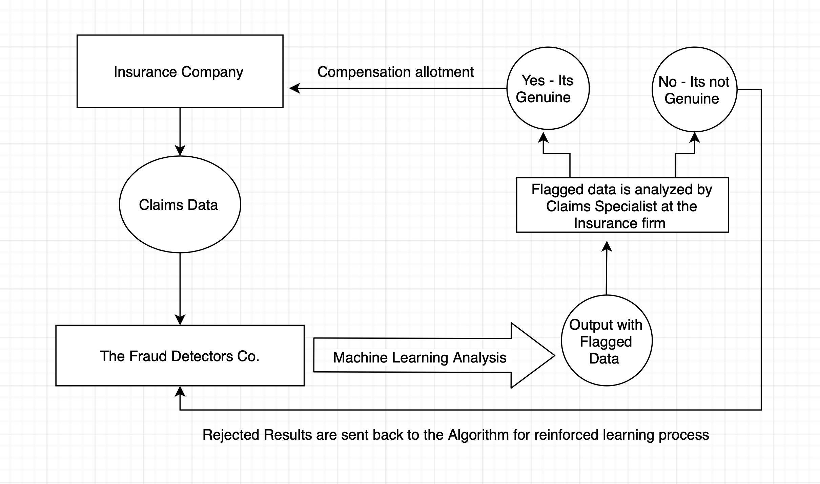
Process flow
SAMANVITH

Slide 8
Algorithms and Storage used
NoSQL is used for data ingestion and streamline data using a prescribed schema to feed the data into the model
The Machine Learning Model uses Random Forest, Natural Language Processing Algorithms to make predictions
The Machine Learning model is deployed using cloud processing platform like Amazon's AWS.
AWS cloud storage is used to securely move the insurance data
SAMANVITH

Slide 9
Data cleaning
Rules for inclusion in algorithm processing:
Time and date of the incident
Date claim filed
Name of the claimant
Incident type (i.e. accident, deer, etc.)
Location
Type of insurance
Yes/No attachments (police report, other parties' insurance, etc.)
Unique identifier
Example of algorithm data and flagging.
Claim ID | Incident Type | Date Time | Claim Date Time | Name | Attachments Available | Location
1 | Accident | 08NOV17 05:00 PM | 14NOV17 11:00 PM | Joe Smith | NA | Frederick, MD
2 | Black ice | 08JAN20 07:00 PM | 09JAN20 08:00 PM | Larry G. | Yes | Tampa, FL
3 | Deer | 09AUG18 06:00 AM | 09AUG18 07:30 AM | Jane Doe | Yes | Baltimore, MD
SAMAANGELA

Slide 10
Cost and Resource Estimate
Average Amazon Web Services Price Estimate^{[1]}
Employee Costs^{[2,3]}
Service | Setting/Purpose | Cost/ month | Cost /year
Simple DB | 10k TB/month in 100 TB/month out | $10,000 | $120,000
Amazon EC2 | Web Server x3 | $730 | $8,760
Amazon EC2 | DB Server x 5 | $1,000 | $12,000
Load Balancing | 1,000 TB/month | $8,200 | $98,400
AWS Support |  | $1,000 | $12,000
Total |  | $20,930 | $251,160
Data Analyst ($65,000) /per
Data Admin ($50,000) /per
Sales
Other Costs
Office space
Internet/security
Marketing and website design
Business costs: licensing, insurance, etc.
[1] “Amazon Web Services Simple Monthly Calculator.” [Accessed: 26-Nov-2019].
[2] “Salary: Data Analyst in Baltimore, MD,” Glassdoor. [Accessed: 26-Nov-2019].
[3]“Data Administrator Salary | PayScale.” [Accessed: 26-Nov-2019].
SAMAANGELA

Slide 11
Comparison of In-house vs. Our Method
In-House
Our Method
Time
One full-time employee (FTE) can evaluate ~50 claims a day (Avg salary $52,000)^{[1]}
Unnecessary investigations to improperly flagged items
Budget
Real FTE cost is 1.25 – 1.4 times base salary^{[2]}
Office costs, hardware, and software
Estimate for an in-house team of 10 employees
($52,000) x 10 x 1.4 = $728,000
Time
Processing time greatly reduced with algorithm vs manual investigation by FTEs
Reduced workload for existing staff
Budget
One-time cost to evaluate data package
No financial commitment beyond subscription/contract length
[1] Salary.com. “Insurance Agent Salary in Maryland.” Salary.com, 2019.
[2] Hadzima , Joseph G. “How Much Does An Employee Cost?” How Much Does An Employee Cost, MIT Sloan School of Management , 2005.
SAMAANGELA

Slide 12
Challenges
Data protection and privacy
Inadequate access to external data
ML requires large datasets to train the model for a real dataset
Changing fraud patterns over time
SRINIVASA VUTUKURI​

Slide 13
Implementation Time Frame
Year 1
Build data and management staff – Identify roles
Find a work location/office
Specify hardware needs at office
Spin up AWS instances for processing and storage.
Build basis of algorithm
Year 2
Test the algorithm with client data (QA testing)
Training and testing algorithm with partnered insurance companies
Return results to partners for two-way feed back
Build user interface by adding web development staff or contract employees
Year 3
Hire marketing and accounts staff
Test user interface with insurance clients
Launch web interface
Increase marketing and accept clients on subscription basis
ANURAG RAMU​

Slide 14
How much do you save ?
Consider a scenario in an Insurance firm with 50 Employees analyzing claims daily basis
Avg Employee Salary/Year = $70,000
Avg Employee Salary for 50 employees/Year = $3,500,000
Avg Employee Salary for 50 employees for 5 years = $17,500,000
Thereby our ML platform could help reduce that number by 50% by reducing the number of claim specialists hired.
Avg Employee Salary for 25 employees/Year = $1,750,000
Avg Employee Salary for 25 employees for 5 years = 8,750,000
Therefore adopting our current ML claims analyzing platform could reduce employee costs by almost 50%
SAMANVITH

Slide 15
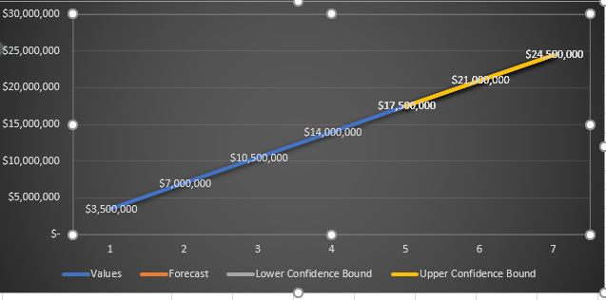
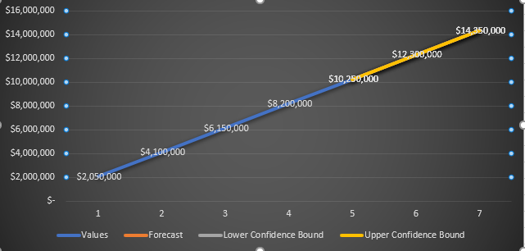
Estimated savings for a typical insurance company
Cost Estimate Without Our Service
Cost Estimate With Our Service
ANURAG RAMU​

Slide 16
Conclusion
Insurance Data
Reduces the number of fraudulent claims being approved wrongfully.
Expedites the time required to detect and investigate fraud claims.
Client staffing needs are less than industry standards.
Flexible cloud framework can reduce and add storage and processing power as needed.
User/Client Web Interface
Our Cloud Service
Fraud Analytics Report
ANURAG RAMU

Slide 17
Questions?

